Slide 1


Game with Procedurally Generated Levels
By Tyler Smith

Slide 2
Overview
2D game from an overhead perspective
Escape from the cultist ghosts
Spooky, cartoony aesthetic
Level(s) are procedurally generated

Slide 3
Procedural Generation for Video Game Levels
Levels created by an algorithm rather than being hand crafted
Adds replay value
The Binding of Isaac and Darkest Dungeon

Slide 4






Tools

Slide 5
Development Process
Create a list of to-dos ordered by priority. Gameplay first, aesthetics and story last.
Development Schedule
February: Research and early development (build basic gameplay system with basic assets and start creating rooms for levels).
March: Finish building rooms and begin developing procedural generation code. Further develop gameplay
April: Finish implementing the procedurally generated levels. Work on improvements to the general gameplay. Implement story and higher quality assets (if there is time).

Slide 6
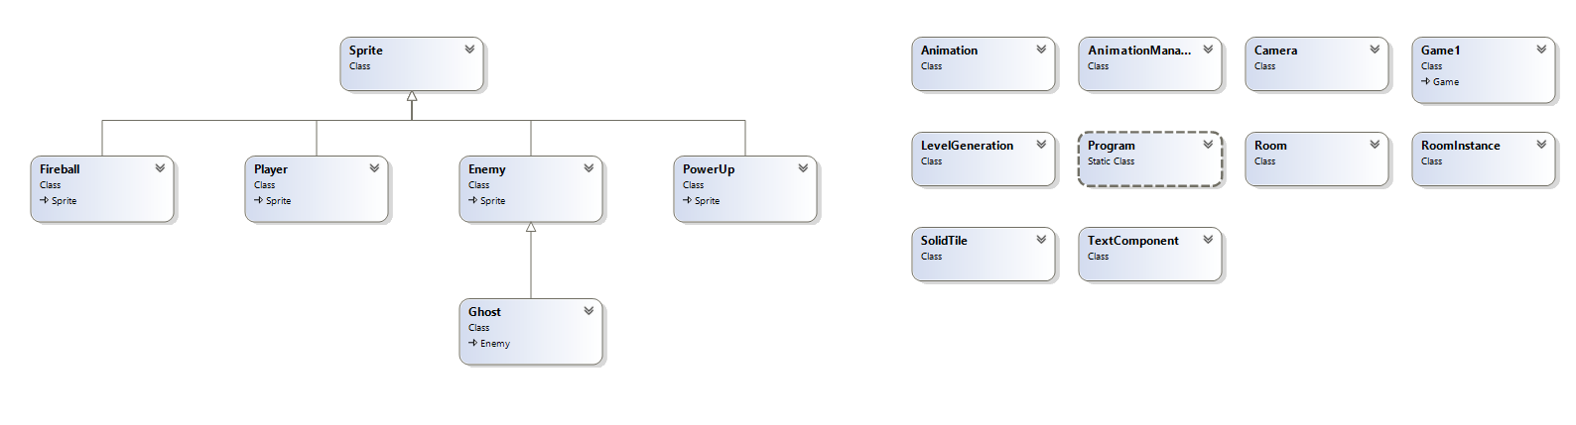
Class Diagram

Slide 7

Procedural Generation Implementation

Slide 8

Procedural Generation Implementation

Slide 9
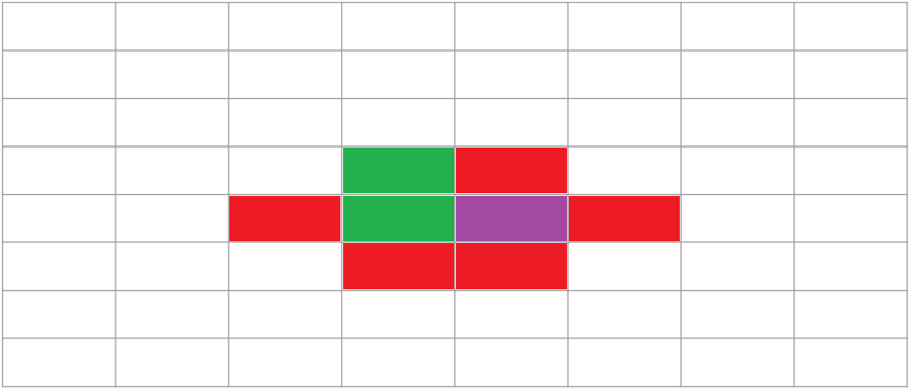
Procedural Generation Implementation

Slide 10
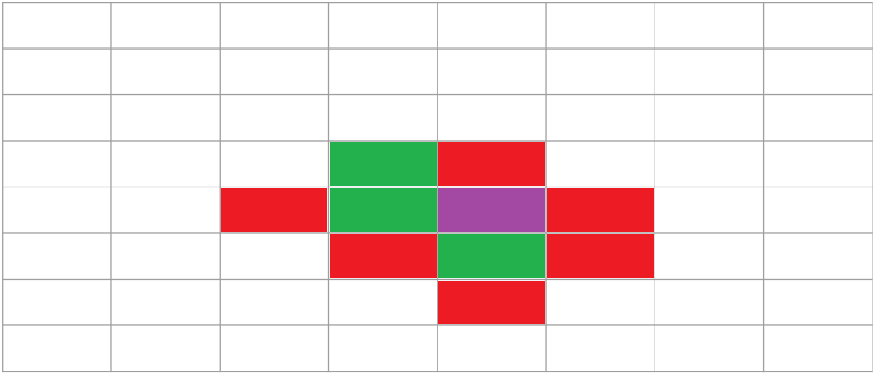
Procedural Generation Implementation

Slide 11
Demo

Slide 12
Future Work
Rework general gameplay to feel better
More enemy types
More tiles, multiple levels
Controller support
Enemy that pursues player and adapts

Slide 13
Questions?

